Slide 1
Lecture 14 – Human-System Interfaces
Notes:
Almost every system we design as engineers interfaces at one time or another with humans. In fact most of the systems we design have humans as an integral part. However very little time is spent in most engineering curricula discussing human capabilities and tolerances. How much force can a human exert when turning a knob for example ? Or how hot can an electrical box be allowed to get before it is a hazard? These are the topics we will address in this lecture.
Entire courses are available in human factors and I encourage budding systems engineers to learn as much as they can about human factors. In almost every design there will be significant interfaces to people. And almost in every case it will be the part of your design over which you will have the least control. After all, when you design something, you usually can’t identify the specific individuals that will use it. Instead you have to design the product to work with a population of humans. The larger the population that your design can accommodate, the more people that can use your design.

Slide 2
Fundamental Truth
Almost every design you will be involved with at one point or another will interface to people
It is the one part of your design over which you have the minimum amount of control
In most cases, you have to design to accommodate the human component because you can’t change it
As such, it is best to understand the nature of humans as component in a system

Slide 3
Human Engineering Issues
Anthroporometry – how big are the humans you need to work with
  Classic problems – seat design in aircraft, cars, trains, buses, etc…
  Spacesuit design, other worn equipment design
  Task design
Limits –
  what kind of loads can humans sustain without injury
    Example Touch limit –
    What kind of loads can humans impart to systems
Support – what kinds of support do humans need – how much oxygen, water, food, what kinds of wastes do they generate
Interfaces – what are good and bad interface practices in workstation and habitability design
NASA STD 3000 – Human Systems Interface Standards contains a wealth of knowledge about this topic… it is located at
http://msis.jsc.nasa.gov/
It is also located…. http://standards.nasa.gov/public/public_detail.taf?Documents_uid1=1609&doc_name=NASA-STD-3000%20VOL%20I
Mil-Std-1472F is the DOD standard on Human Engineering and it is also a great resource . It is located at
http://www.weibull.com/knowledge/milhdbk.htm
There is much commonality between Mil-Std-1472f and NASA STD-3000
  The Mil-Std is more general and the NASA STD-3000 contains more spacecraft specific knowledge
The FAA also has a human factors design standards for commercial and general aviation aircraft
  http://hf.tc.faa.gov/hfds/
The Society of Automotive Engineers also maintains human factors requirements
  200 standards as of July 2010

Slide 4
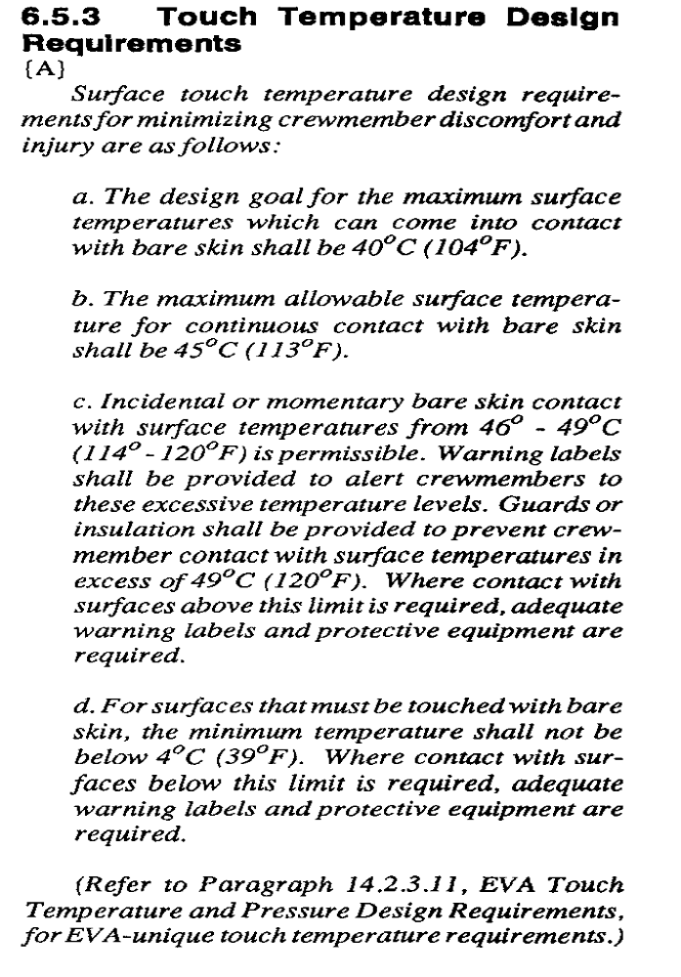
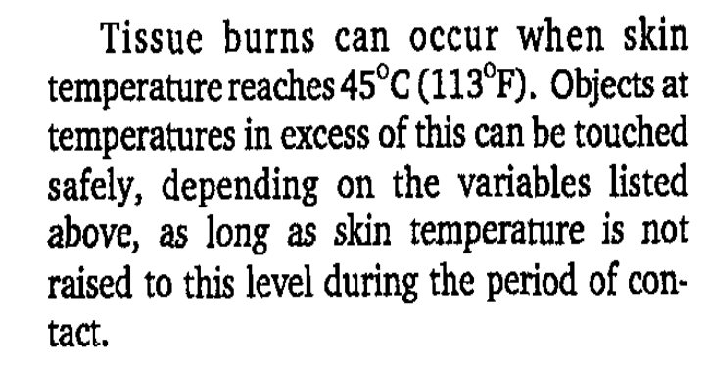
Example – Touch
Temperature
Notes:
Touch temperature is an important example of human performance or tolerance requirements. Things over 120 degF to bare skin cause skin damage and pain. This is a remarkably small range given that human normal temperature is 98.6 degF
.
Source: NASA STD-3000

Slide 5
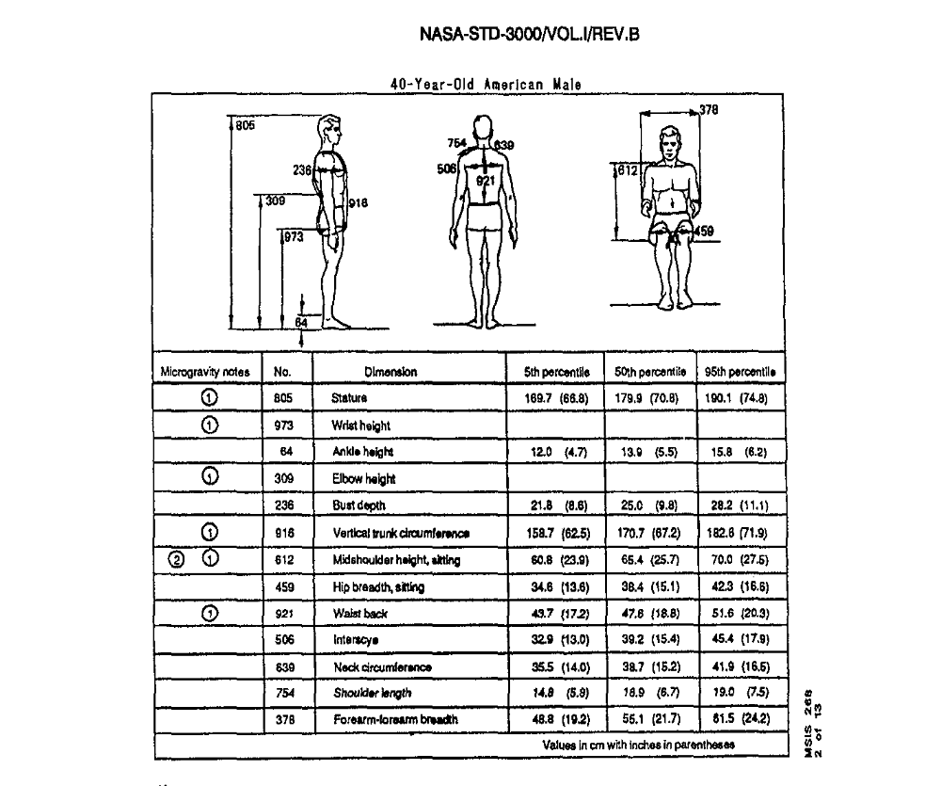
Example of Anthroporometry
Notes:
The next six pages show diagrams identifying different body dimensions and detailing the 5%, 50th and 95% human population sizes for this dimension.
When something is 5% percentile it means that only 5% of the selected human population fits below this this dimension. When something is 95 percentile it means that 95% of the human population is below this dimension.
Obviously when designing cars, boats, trains, planes and consumer goods, you want to meet as large a population as you can to maximize the types of customers you can handle.
In the military and NASA we can sometimes limit populations, as we do size limits for the astronaut corps
Source: NASA STD-3000

Slide 6
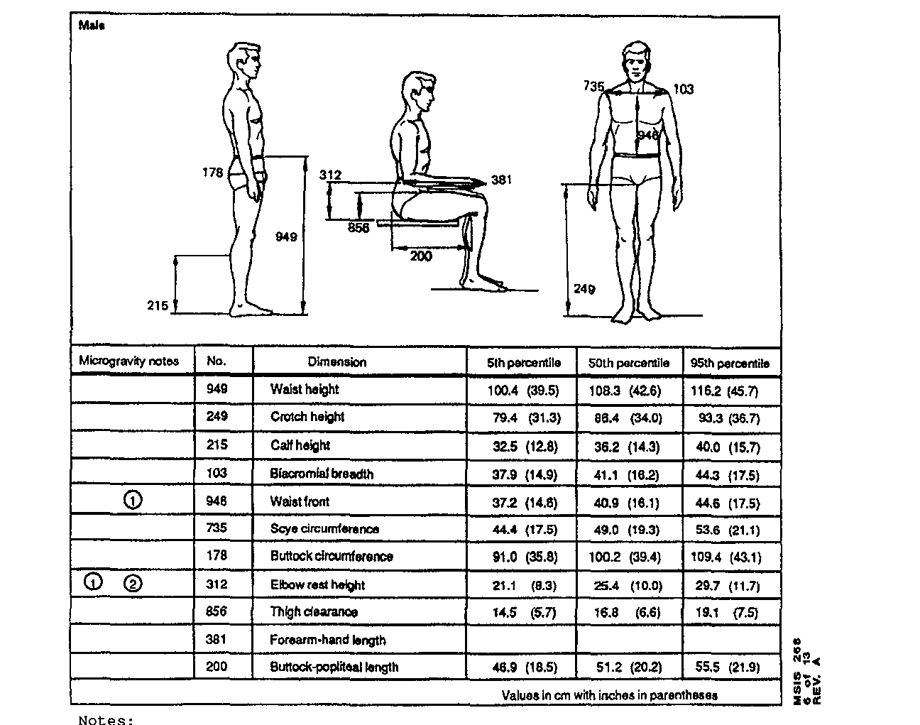
Notes:
The sitting height dimensions are obvioulsy important for crew station design
Source: NASA STD-3000

Slide 7
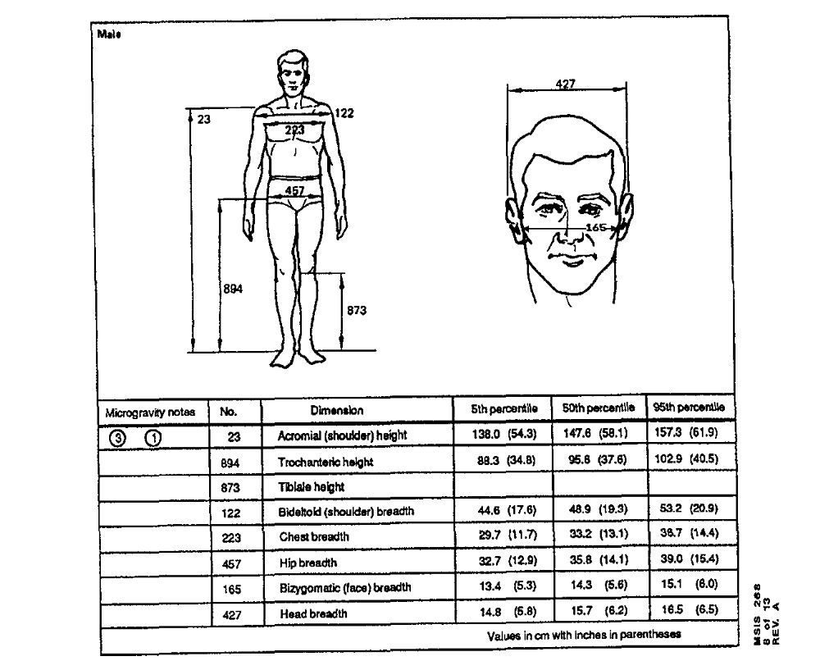
Notes:
The head dimensions are important for helmets, visors and masks as well as for determining angles for viewing
Source: NASA STD-3000

Slide 8
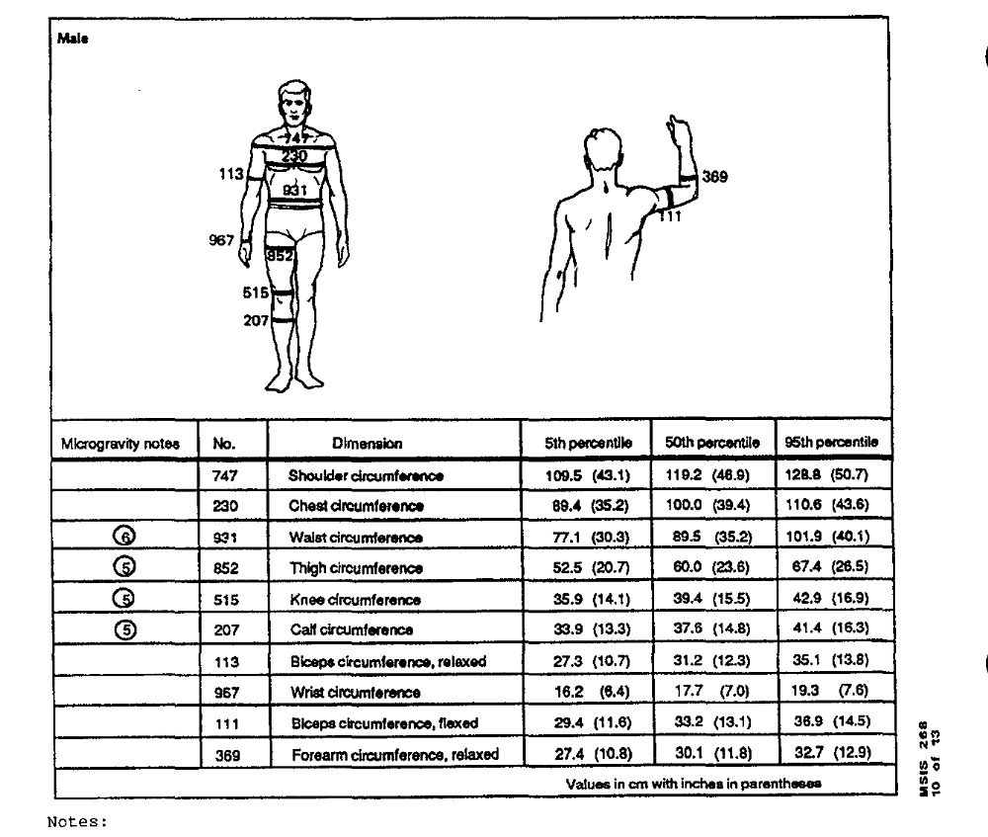
Notes:
Source: NASA STD-3000

Slide 9
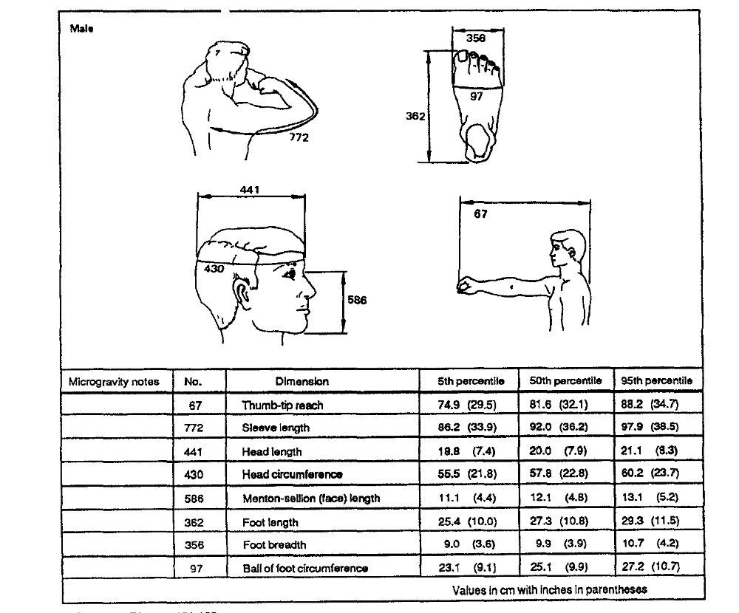
Notes:
Source: NASA STD-3000

Slide 10
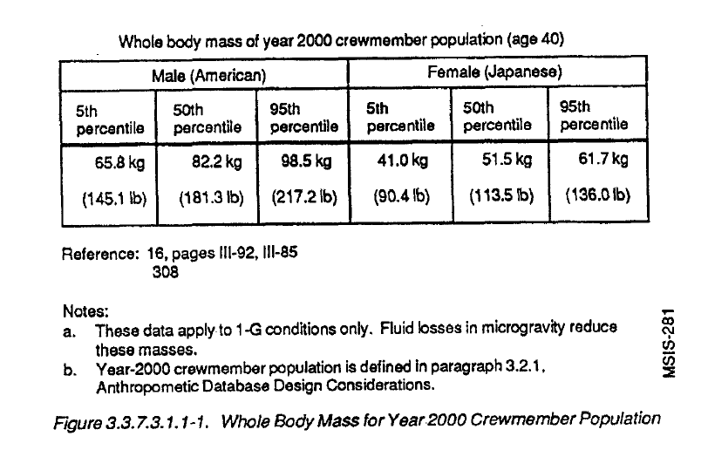
Notes:
This chart shows how you can restrict your sizes based on a specific population. Here NASA computed the whole body mass of its crew and computed it for American males (the larger population) and Japanese females. In general NASA specifications require all crew accommodations to be able to be used by anyone ranging in size from a 95% American male (crewmember population) to 5% Japanese female.
How might this be used. Well say for example that you are designing a crew couch or seat. In a crash it might have shock absorbing materials that crush to absorb impact loads. This crush material would have to be able to decelerate anyone ranging in size from a 5% Japanese female to a 95% American male. A material that was too stuff would not crush under the 5% Japanese female and submit that crew member to a hard landing. Similarly a material too soft would crush too far for a 95% American male and potentially injure that crewmember. So the proper rage of material stiffness is determined base don weight range that must be protected.
Source: NASA STD-3000

Slide 11
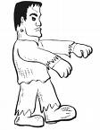
So you know the 95% american male dimensions, is this enough ?
  No – if you build a model human with all 95% dimensions , it would look like Frankenstein’s monster because no one is 95% in all dimensions
  What you have to do is look at each design problem and determine the parameters which are critical to the design and ensure that it can support 95% percentile in those critical parameters
  When you need an entire model person , for example for a crew occupancy study, you build a composite model from all of the critical components that results in a body solution that is within the 95% height
    May actually need several models – a long legged, a short legged long torso, etc…

Slide 12
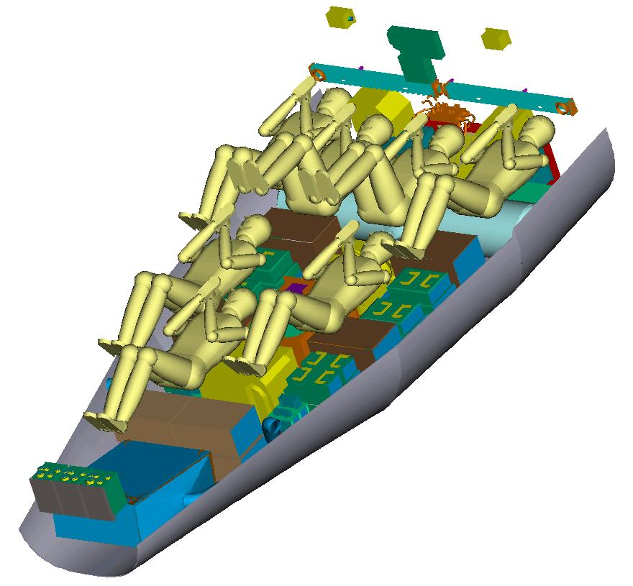
X-38 cabin with reference 95% american male models
Notes:
For the X-38 crew return vehicle for the International Space Station (a combined ambulance-lifeboat for the space station) we had the requirement to design to meet the range of a 5% Japanese female to a 95% American male (crewmember population). So we put together model humans in our Computer Aided Design that were 95% in the dimensions that were critical for couch design and layout. These were 95% in all dimensions, just in the ones that were important to the design. For example, foot length wasnt a big factor here.

Slide 13
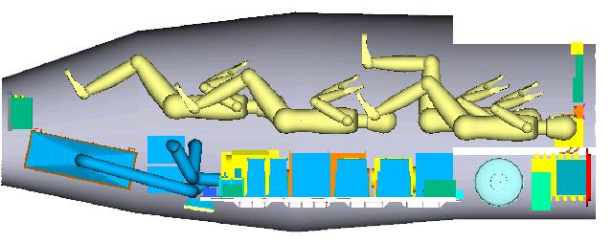
X-38 cabin with reference 95% american male models

Slide 14
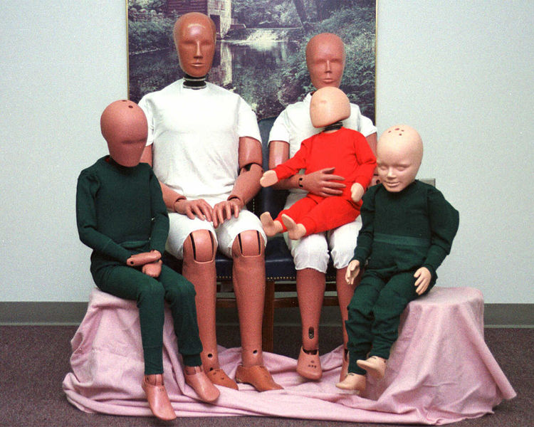
Crash test dummies with a 95% american male, a 5% american female and ten, six and three year old dummies. From wikipedia.com
Notes:
This gives you an interesting comparison for the range of sizes. Here are crash dummies ranging from a 95% American male to a 5% American female as well as family members.
Note how the ratio different body parts changes with age. A child’s head is proportionally a larger part of their body than an adults.
Instrumented crash test dummies, made famous on Mythbusters, are actually an important tool in automotive and aerospace safety testing.

Slide 15
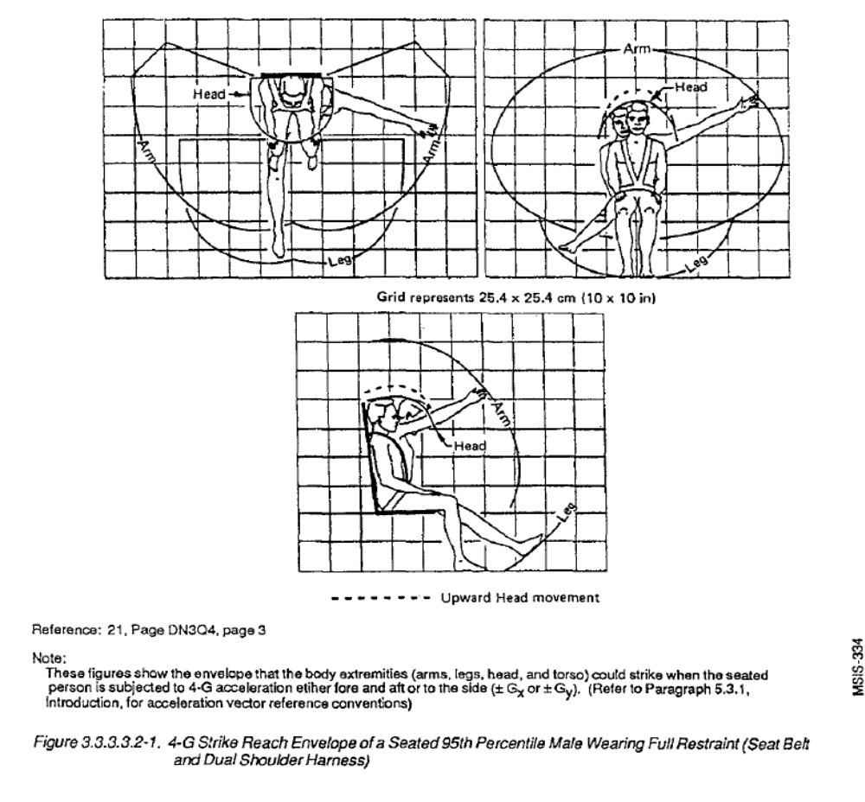
Reach and Visibility Limits
Notes:
A very important factor in crew station design are reach and visibility limits. Cockpit designers need to know what can a crewmember see and where can they reach when restrained in a crew seat by safety straps. They also need to know how G-loading due to acceleration due to turns or speed changes affect ths reach and visibility limits.
Source: NASA STD-3000

Slide 16
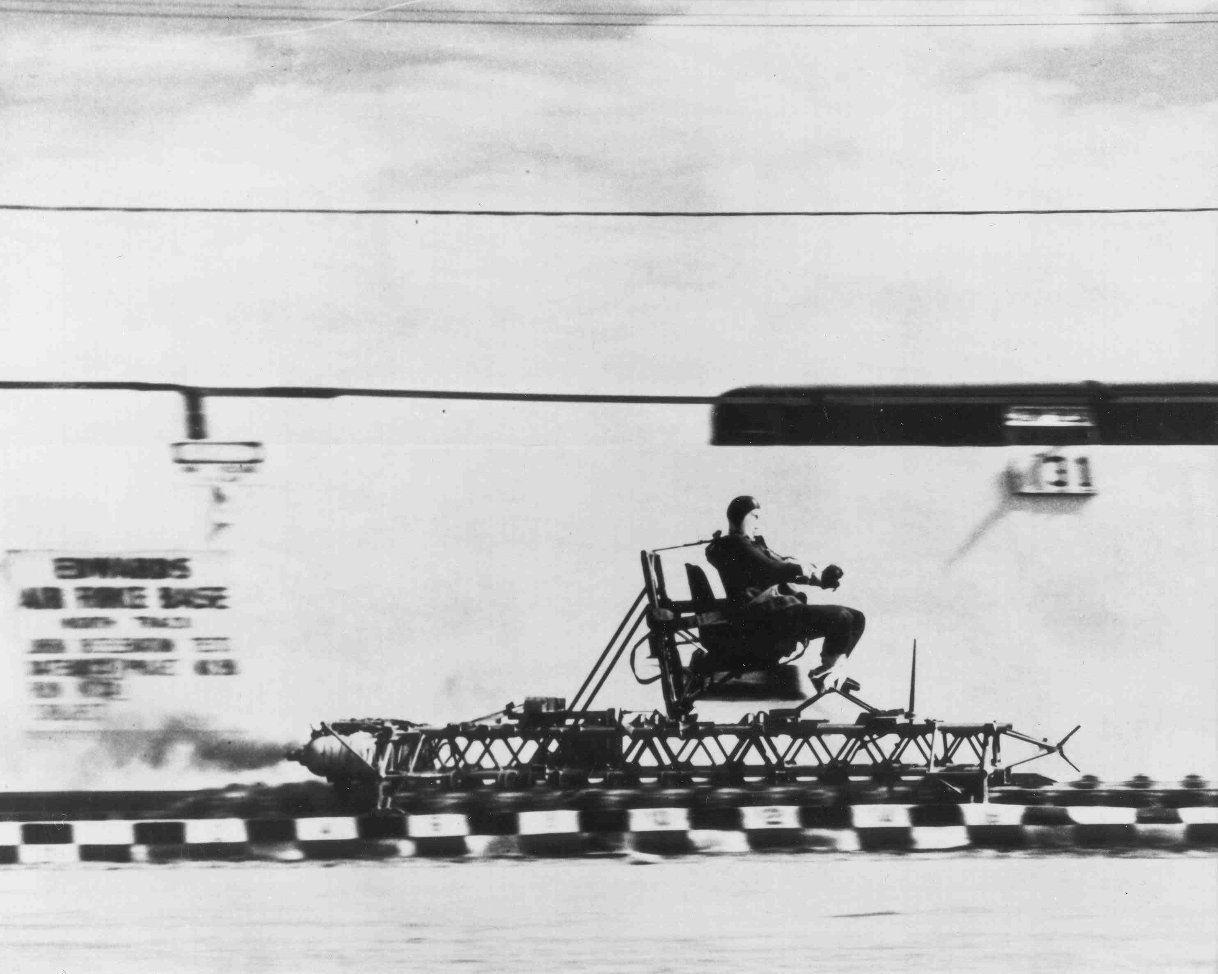
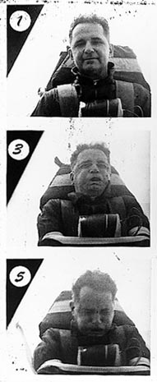
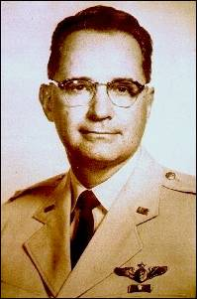
John Paul Stapp and determining human G limits
When he began his research in 1947, the aerospace conventional wisdom was a man would suffer fatally around 18 g. Stapp shattered this barrier in the process of his progressive work, experiencing more "peak" g-forces than any other human. Stapp suffered repeated and various injuries including broken limbs, ribs, and miscellaneous traumas… In one of his final rocket-propelled rides, Stapp was subjected to 46.2 times the force of gravity (wikipedia)
One of the bravest officers in the history of the United States Air Force. His work convinced the industry to put crash provisions in the aircraft to protect occupants up to demonstrated survivable limits
He also championed automobile safety and is one of the primary people responsible for seat belts in cars today
Notes:
Perhaps one of the bravest officers in the history of the United States Air Force was Colonel John Stapp. He repeatedly subjected himself to crushing deceleration forces to prove that people could survive short periods of high G’s. This forced military aircraft designers to design safety straps and cockpits to protect crewmembers during crashes. Previous to his efforts it was believed that anything over 18 g’s would kill a human. So aircraft were not designed to stay together for anything with loads greater than that. Stapp proved that higher deceleration levels for short periods of time were very survivable forcing cockpits to be designed to allow people to survive crashes. Before Stapp, pilots often survived the crash only to be killed by the collapsing aircraft around them.
After his success in this program, which only ended because his commanding officers refused to let him go on, Stapp went on to realize that as many air force pilots were getting killed in car crashes as plane crashes. This started a series of work which resulted in Stapp championing seat belts in cars. When President Johnson signed the legislation in the 1960’s making seat belts mandatory, John Stapp was standing behind him. His work has saved countless lives in car crashes.
His effect on human survival in crashes was so important that every year the auto industry has a safety conference named after him.
Stapp is recorded in history for another reason. An officer working on the test instrumentation named Murphy worked for him. Murphy commented on a technicians work saying “If it could be wired wrong, the technician would find a way to wire it wrong”. This was generalized into Murphy’sLaw – “If it can go wrong, it will” which is very important for systems engineers to remember.

Slide 17
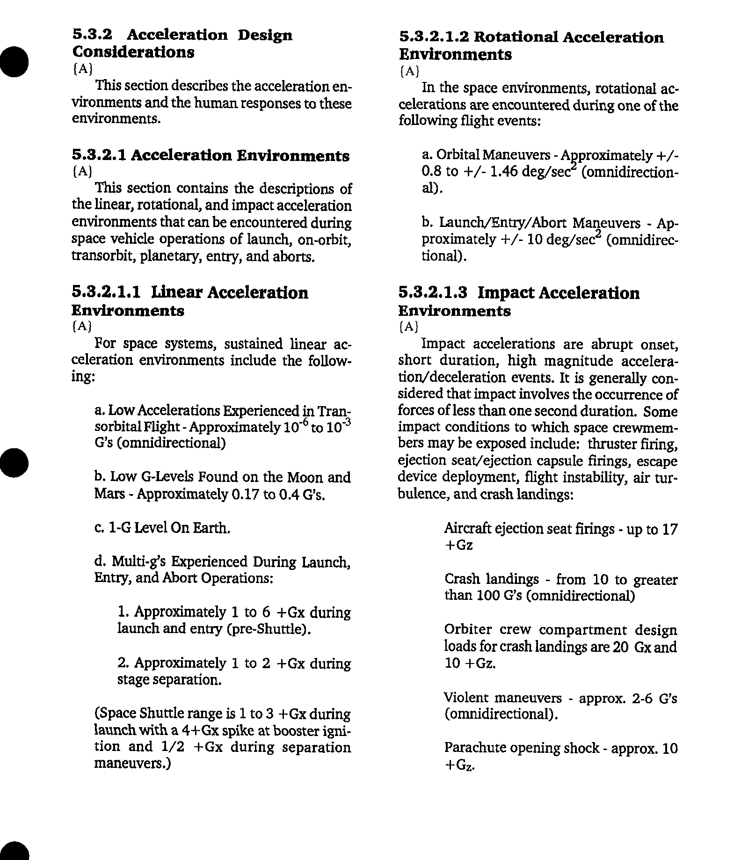
Acceleration Limits
Notes:
This shows NASA STD-3000 limit son acceleration for humans. Note that impact limits , which are typically of very short duration (high frequency) are separated from static or quasi static limits on acceleration. Dynamic or shock limits (like hammer blows or impacts) are always very hard to specify as they often are affected strongly by the frequency response of the item being impacted.
Source: NASA STD-3000

Slide 18
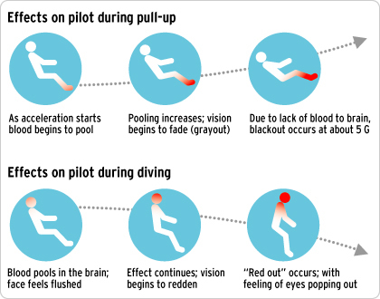
Redout and Blackout During Accelerated Flight
http://www.wellnessoptions.ca/html/1/011/1_i11_2_main.html
Notes:
Static or quasi static accelerations affect human operators in predictable ways. Human pilots in aircraft suffer from two distinct phenomena called black out and red out. In black out, the visual field starts to collapse and turn gray and then black before consciousness is lost. In red out the visual field actually goes red . Avoiding red out is why combat aircraft usually roll inverted and pull nose down to rapidly lose altitude rather than simply push over into a dive.

Slide 19
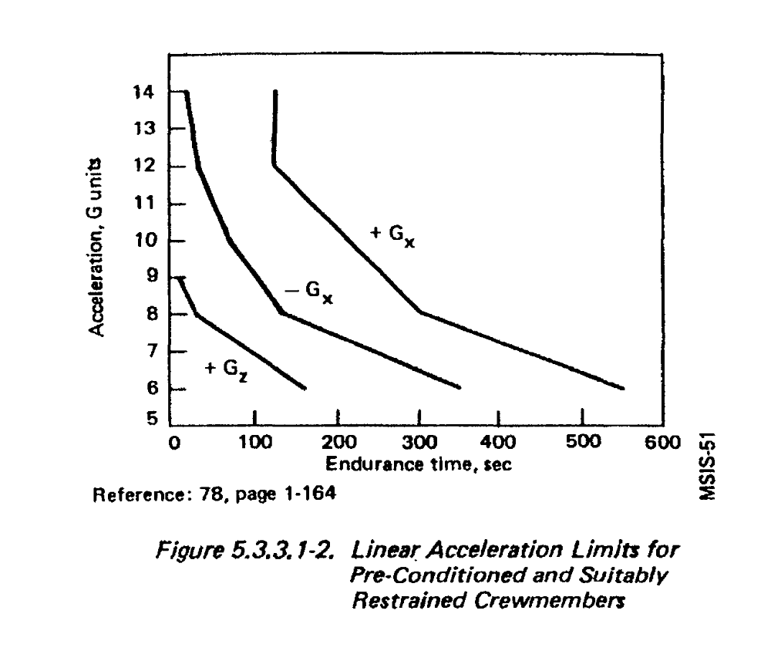
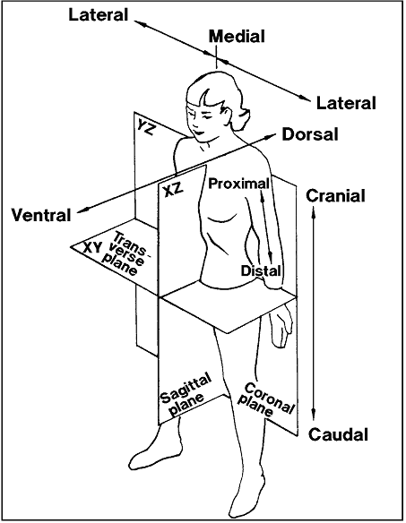
Reference coordinate system
X axis – through center of chest and back
Y axis - through right and left arm
Z axis – feet to toes
Notes:
Note that the G limits are very different based on the direction in which they are received. Note that there are no limits in y because this dimension has very little effect on consciousness and vital functions.
Source: NASA STD-3000

Slide 20
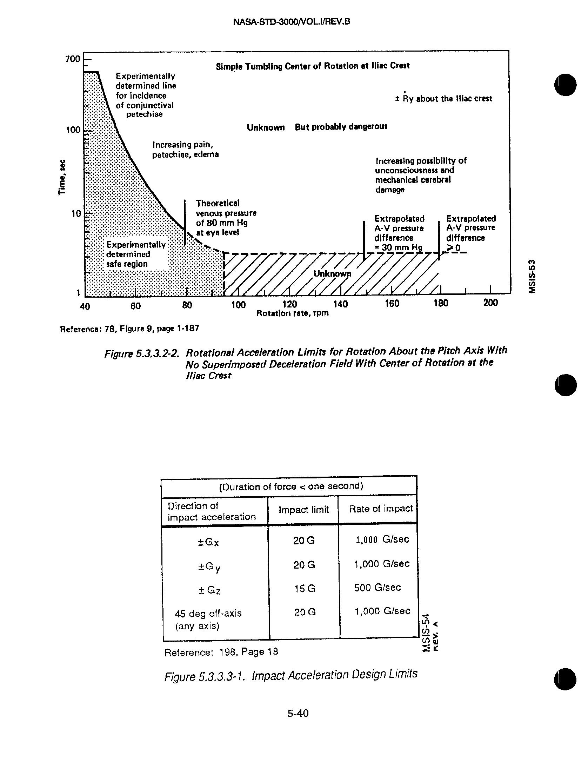
Rate limits
Impact Acceleration Limits
Notes:
This chart addresses two issues
First what are the rotation rate limits. I’m sure that anyone who has ever ridden a carnival ride has wondered about this.
The second is impact g limits. Note that these limits are significantly lower than those survived by Col Stapp who suffered serious injuries during his tests. Note that these are specified at level and onset rate. This is a actually a poor attempt at trying to understand dynamic impacts. A far superior method, the Brinkley index, will be discussed in a few charts.
Source: NASA STD-3000

Slide 21
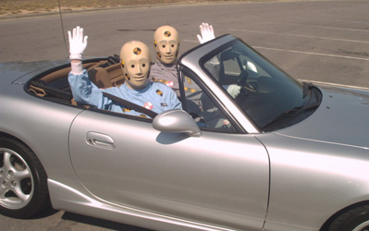

I couldn’t resist – Vince and Larry – from wikipedia
Seriously – crash test dummies are a vital part of testing in aerospace engineering to measure rates and accelerations in crash or impact scenarios. Their use is slowly being replaced by computer modeling but they are still used for verification tests. – picture of dummy and computer model from First Technology http://www.ftss.com/pcat/products.cfm?pcat=h3-95m&class=1&x=500&y=905

Slide 22
In most vehicle impacts
There are actually three impacts
  The impact of the vehicle to an obstruction
  The impact of the human occupant to the internals of the vehicle
  The impact of the humans organs (heart lung, kidneys, spleen, brain etc… )to the internal walls of the body such as the rib cage or skull

Slide 23
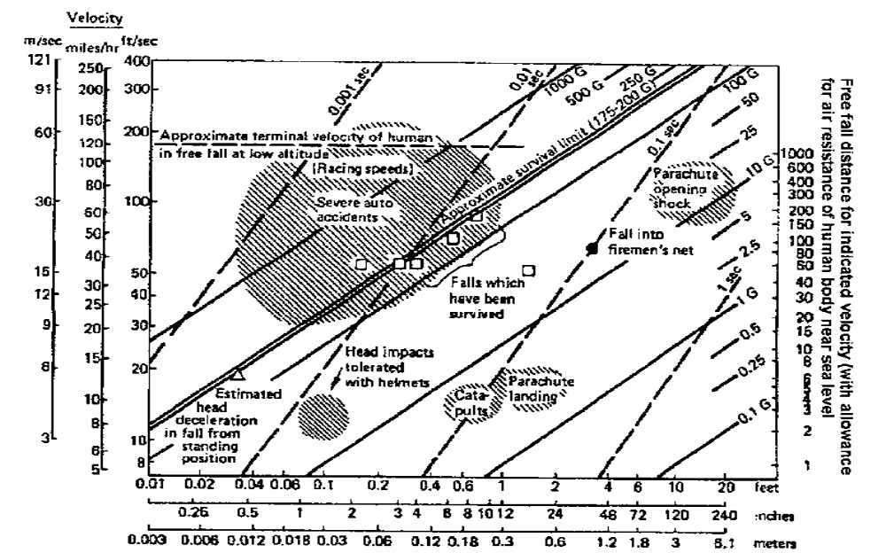
Notes:
This chart is also an attempt to understand the complex dynamic impact story associated with falls and crashes. People took experience and then tried to characterize it in terms of velocity and deceleration distance. In fact the story is way more complex than be characterized in a 2-d chart. It is interesting how they characterized areas with clouds as a way of understanding the uncertainty associated with the regions.
Source: NASA STD-3000

Slide 24
Fourier’s Theorem and impact loads
In mathematics, a Fourier series decomposes a periodic function or periodic signal into a sum of simple oscillating functions, namely sines and cosines (or complex exponentials).
Fourier series were introduced by Joseph Fourier (1768–1830) for the purpose of solving the heat equation in a metal plate.
A single impact, like a hammer strike, can be modeled as the sum of a series of sine waves
  Thus an impact can be viewed as having high and low frequency components
  an object being struck receives vibrations across a wide set of frequencies
  An object being struck will ring if its own resonant frequency is excited by the frequencies resident in the impact
  This is how a bell rings !
    The natural frequency of the bell is determined by the bell shape and determines the tone of the bell
Human beings ring like a bell when struck by an impact also
The ringing can cause structures to tear away from each other and cause fatal damage
This is why people with apparently little exterior impact damage can actually have fatal internal damage

Slide 25
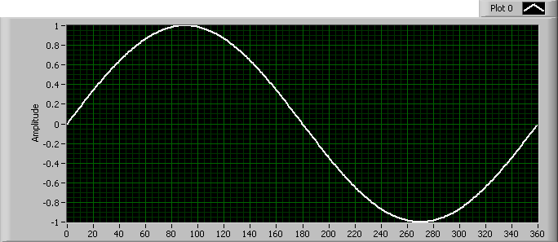
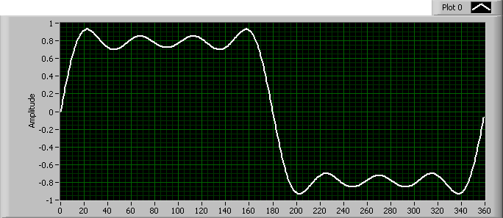
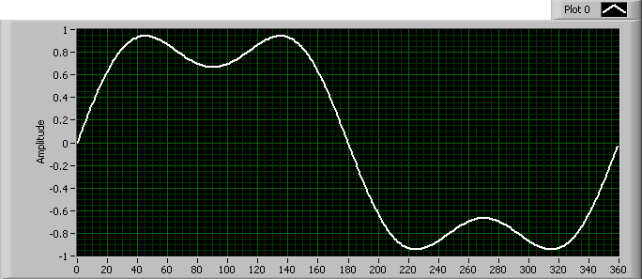

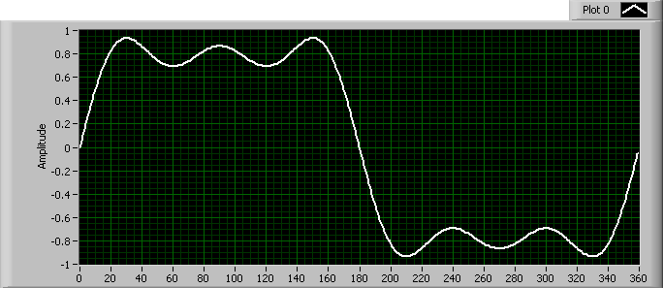
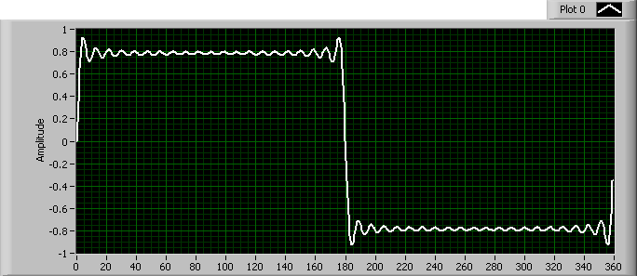
Fourier square wave – How a pulse can be made from a sum of sine waves
N=0
N=3
N=1
N=4
N=2
N=20
Notes:
This shows how by adding sine waves together a square pulse can be created .
The N is the number of additional waves added to the first sine wave.
Note that by N=20, a very sharp edge has been developed

Slide 26
Human Body Resonant frequencies
Notes:
Note that there are several resonant frequencies at low frequencies. In particular in the thorax, abdomen and chest.
Source: NASA STD-3000

Slide 27
Brinkley Model
The “gold standard” in aerospace engineering for evaluating impact and dynamic events on humans is the Brinkley model
Developed at Wright Patterson Air Force Base it is a dynamic response model which takes a time history of acceleration data and determines human organ response and compares it to limits for tissue damage
Based on a comprehensive study of human survival with ejection seats and animal test data
For NASA, we add conservatism to the model to account for the deconditioning that occurs due to weightlessness

Slide 28
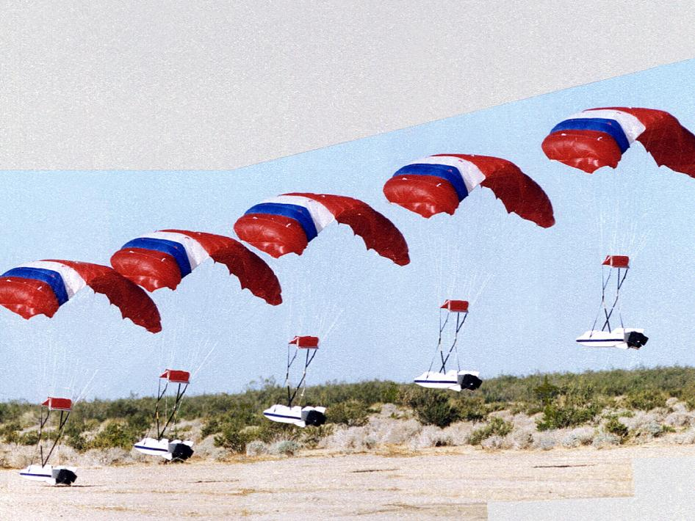
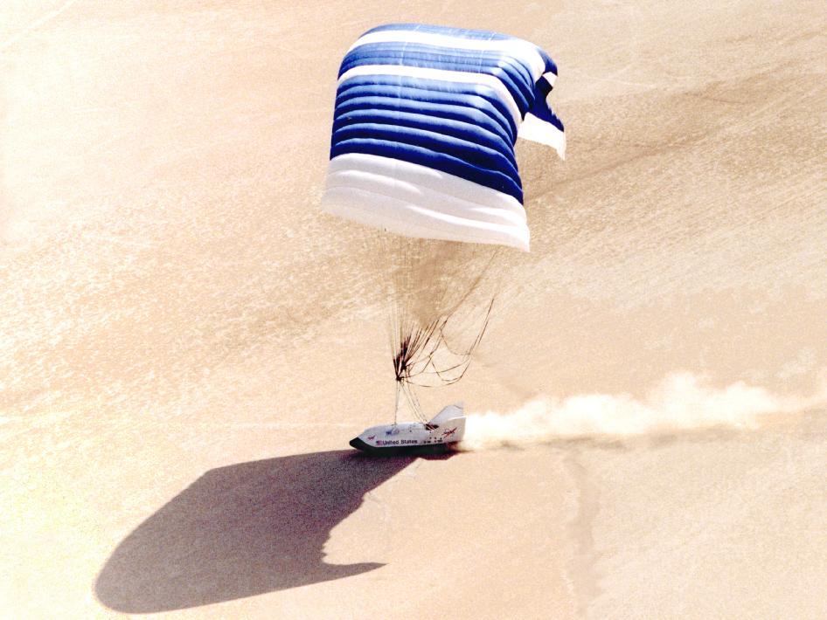
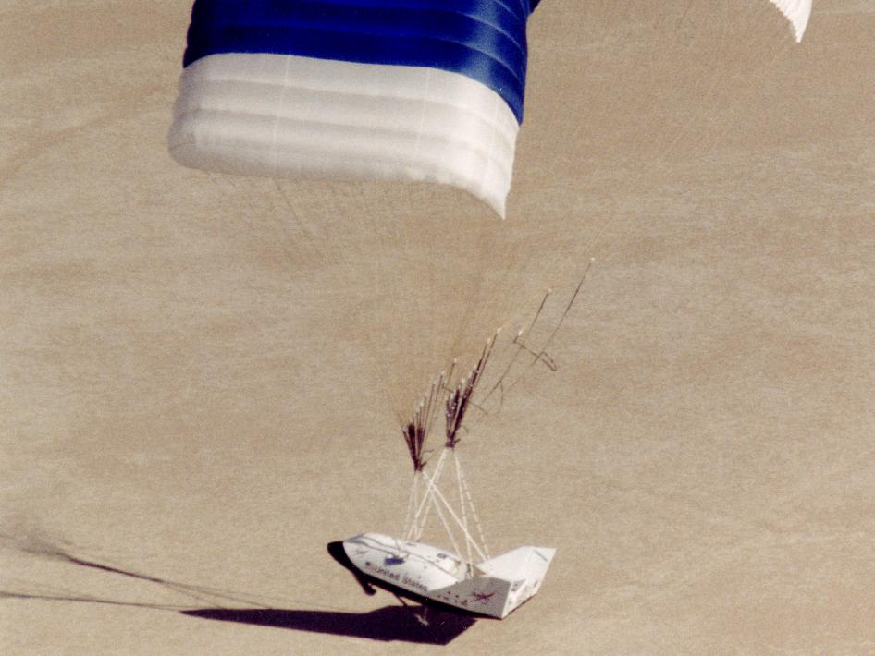
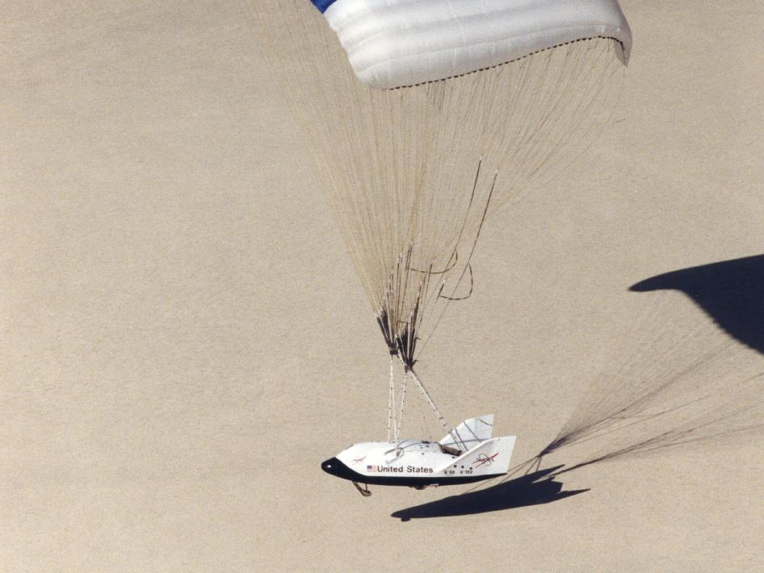
X-38 Subscale Landing – 100 lbs
X-38 Full Scale Flare and Landing – 25,000 lbs
Notes:
The X-38 Space Station ambulance-lifeboat program conducted 8 full scale landing tests in 1998-2002, Flying at near supersonic speeds when dropped from a B-52 bomber from as high as 50,000 feet, the 25,000 lb vehicle flew as a lifting body eventually deploying a 7500 sq ft parafoil for final descent and landing. The 7500 sq ft parafoil which deployed dynamically at 15,000 feet can be compared to the 5500 sq ft wing area of a Boeing 747.
This parafoil allowed the X-38 to land very gently by executing a landing flare when a laser altimeter indicated the vehicle was close to the ground. A GPS based navigation system allowed the vehicle to steer into the wind for touchdown at low speeds.

Slide 29
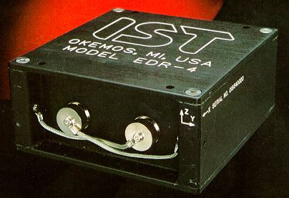
X-38 Human Tolerance Design Analysis
Primary objective of the analysis: to assess the effect of landing impact on a deconditioned crew.
Analysis Math Model:
  sanctioned by the NASA-STD-3000 documentation.
  developed by Wright Patterson AFB for ejection seat human tolerance analysis.
  extensive discussions held with model developers to certify usage for landing impact analysis.
  inputs are filtered high impact accelerometer data from a hard-mounted instrument not taking into consideration any couch damping effects.
  currently assumes the crew sits in the vehicle with feet forward in the vehicle nose and back against the bottom of the vehicle.
  Injury-Risk Criteria = function of dynamic response compared to limits based on compiled medical data for a deconditioned crew.
  If IRC is greater than one, then the risk category is the next level:
    low risk level (less than 0.5% chance of incapacitating injury)
    moderate risk level (0.5% to 5% chance of incapacitating injury)
    high risk level (5% to 50% chance of incapacitating injury)
Notes:
The picture in the lower left is of the recording accelerometers used on the x-38.
The chart describes the process used to determine if the X-38 landing was safe for humans.

Slide 30
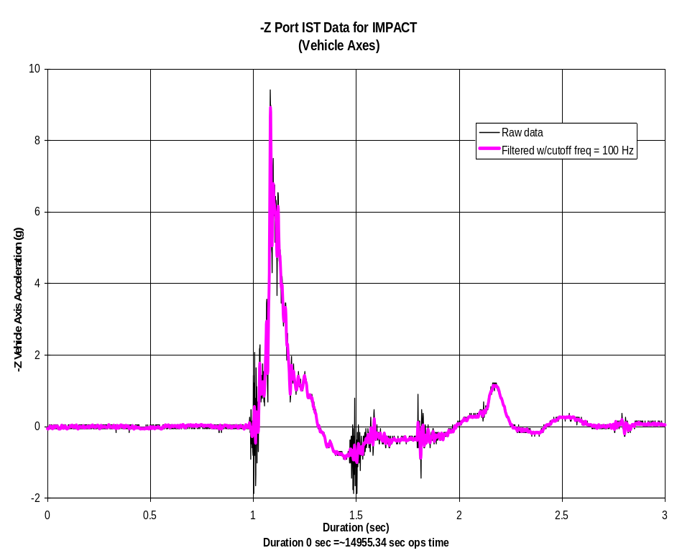
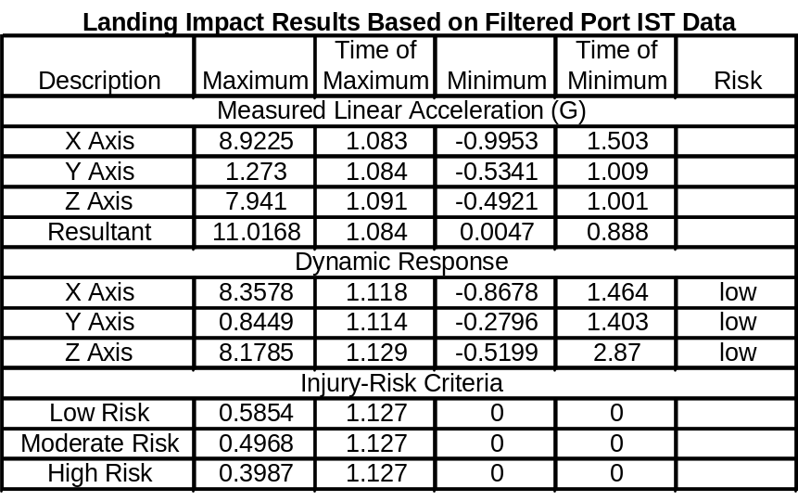
X-38 Human Tolerance Design Analysis:
Example FF1 Impact Data
Peak filtered g’s in the vertical and horizontal: 9 and 8 respectively
Landing rating: LOW RISK or less than 0.5% of incapacitating injury to a deconditioned crew.
Implies there is less than 0.5% chance of incapacitating injury.
FF1 was the first flight test with a ranking of low risk.
Notes:
The chart on the lower left shows the recorded accelerometer from the landing.It was filtered to eliminate the high frequencies that cannot couple into the human body (remember the resonant frequency chart). The table on the right summarizes the data from the landing test.

Slide 31
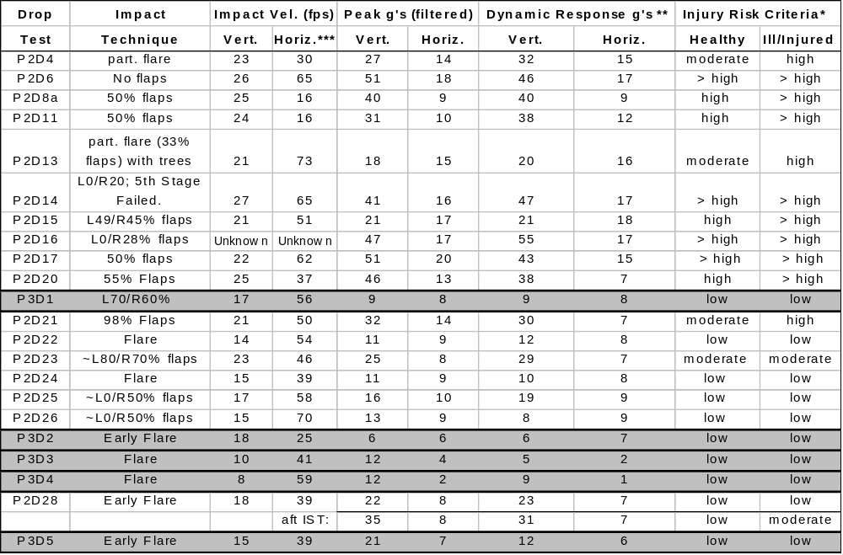
X-38 Human Tolerance Design Analysis
Brinkley Model Inputs: deconditioned crew; IST data filtered as per Brinkley specs; crew backs parallel to pallet, feet forward.
  * high risk level (5% to 50% chance of incapacitating injury)
  moderate risk level (0.5% to 5% chance of incapacitating injury)
  low risk level (less than 0.5% chance of incapacitating injury)
  ** peak acceleration of the human body response to impact loads (human body modeled as a spring-mass-damper system)
  *** wrt ground
Notes:
This chart summarizes how the landing flare system of the X-38 was improved through a series of tests. The P2 designated tests used the parafoil system deployed from a pallet dropped from a C-130 aircraft at the Army’s Yuma Proving Ground. The P3 series used the X-38 lifting body dropped from the B-52 at Dryden Flight Research Facility in Edwards California.
The technique column describes how the flap settings were use dto perform a landing flare to decelerate prior to landing.

Slide 32
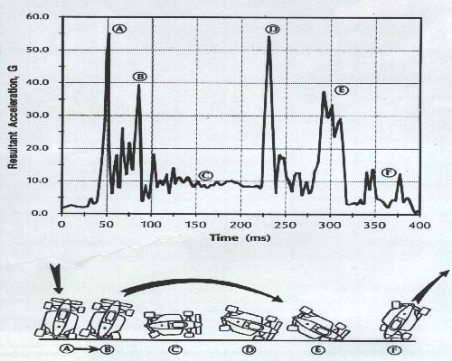
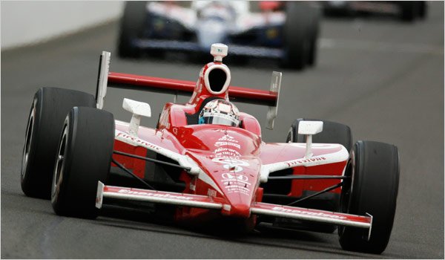
Notes:
The same type of impact technology is used to understand racing car crashes and is one of the major reasons that car racing has become significantly safer. The same company that provided accelerometers for the X-38 tests also provides recording accelerometers for racing cars,
The trace shows the impacts in gs for the crash sequence shown below.

Slide 33
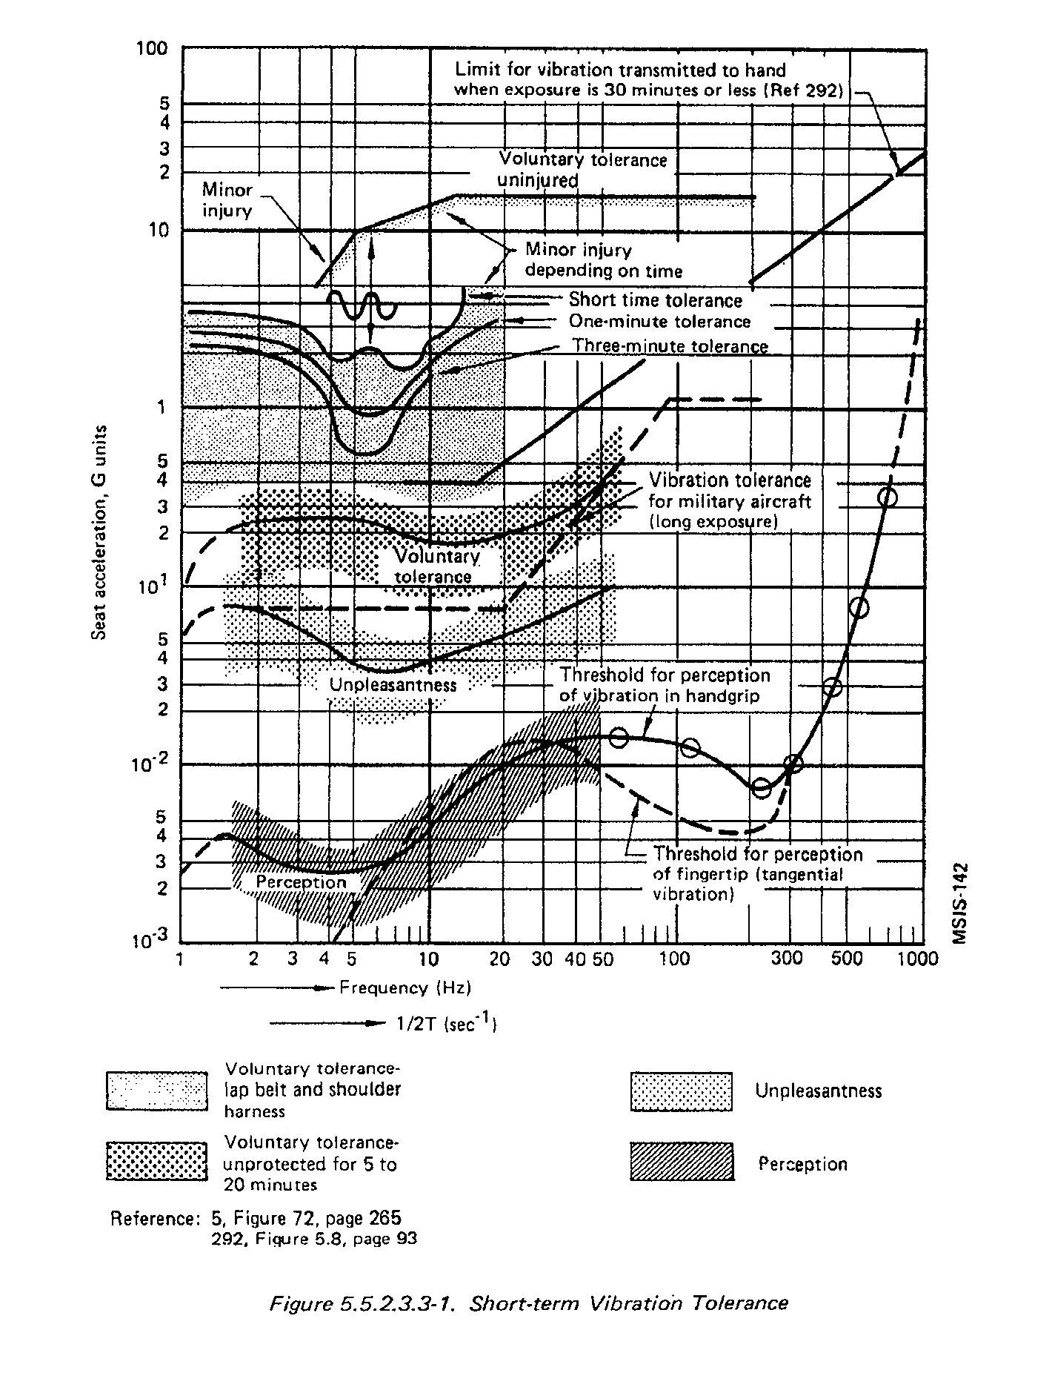
Vibration limits
Notes:
Vibration is yet another environment that must be within human tolerance. It is interesting that vibration has a low perception level and then goes through voluntary tolerance, through short term tolerance, through minor injury to major injury.
Note that this has been characterized both at g level and at frequency.
Source: NASA STD-3000

Slide 34
Notes:
Noise is pressure vibrations in the air, typically ranging from 20 hz to 4000 hz.
Noise can cause a wide range of effects based on intensity – measured as overall sound pressure level in decibels and frequency. A decibel = 20 log(sound level/reference sound level = 20 microPascals)
It is interesting to note the range of human response ranging from gag reflex to lethality.
Source: NASA STD-3000

Slide 35
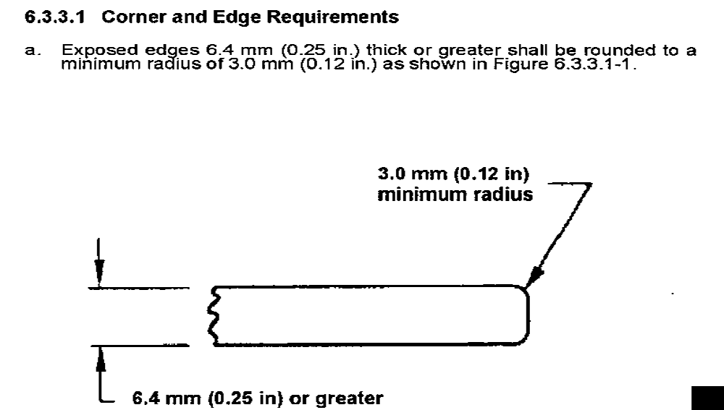
Avoiding Cut Hazards
Notes:
It is also really important that humans avoid injury from cuts. This is particularly true in spacecraft where a crewmember may drift in weightlessness into a sharp edge. This could even be deadly if a suited astronaut external to a spacecraft drifted into a sharp edge.
But what is sharp ? It turns out that sharpness is a function of the radius.
Source: NASA STD-3000

Slide 36
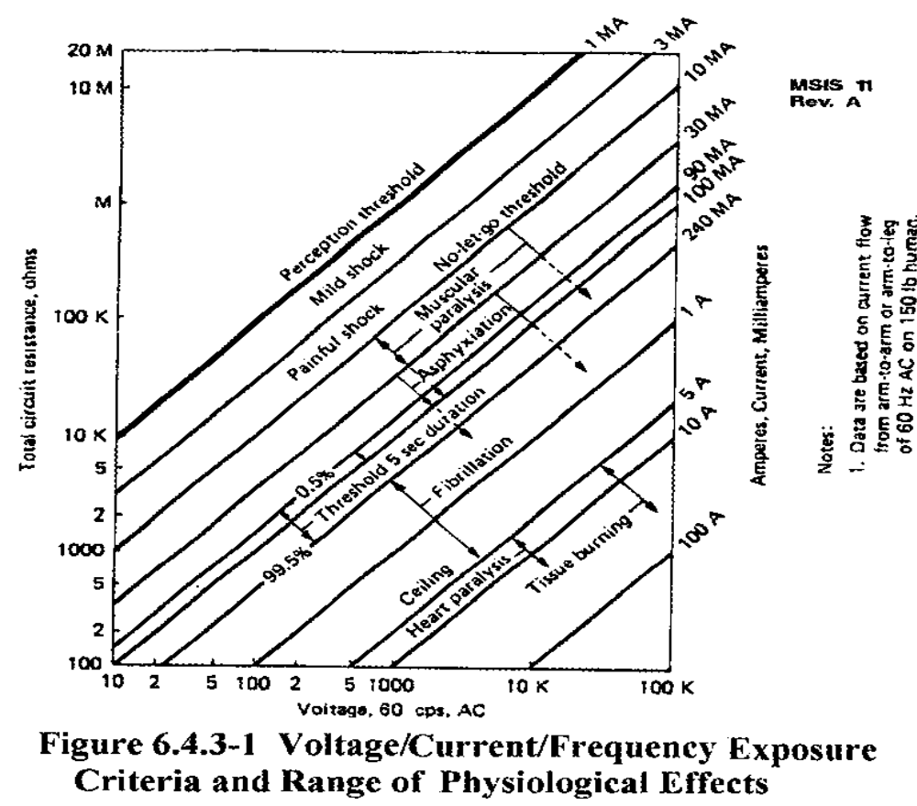
Electrical Shocks
Notes:
Electrical shocks also represent a major human tolerance issue. Unfortunately the frequency used for AC electrical power in the United States, 60 hz, couples particularly well into human nervous systems which are electrically based. Note that the voltage that is deadly depends on the total circuit resistance. This is why standing in liquids or being covered by liquids is so dangerous with electrical circuitry.
Note that current really determines the damage that occurs and current is a function of voltage and resistance (Current = Voltage/Resistance). Note that heart fibrilation (loss of normal heart rhythm) can occur in currents as low as 1 ampere. 1 ampere is a very low level of current. Typically house circuit breakers, which are designed to prevent wiring from burning, allow 20 amps or more through a short circuit before they open. This is more than enough to completely fry a human being. This is why ground fault current interrupters (GFCIs) are required to be installed in kitchens and bathrooms where wet surfaces can cause circuit resistance to be lowered causing dangerous current levels relatively used,
The No Let Go threshold is very important. At this current level, human muscles contract causing an electrocuted person to be unable to release an electrified surface which has been accidentally been grabbed.
Source: NASA STD-3000

Slide 37
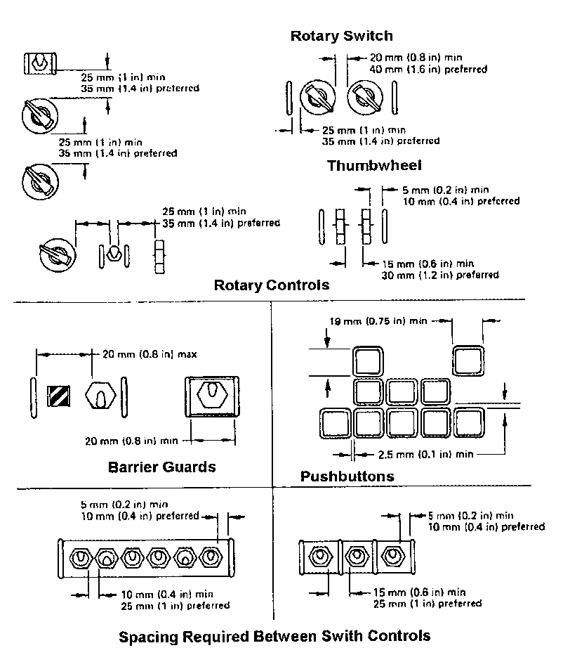
Notes:
Controls can be placed well or poorly and all of the standards identify proper locations for controls.
Source: NASA STD-3000

Slide 38
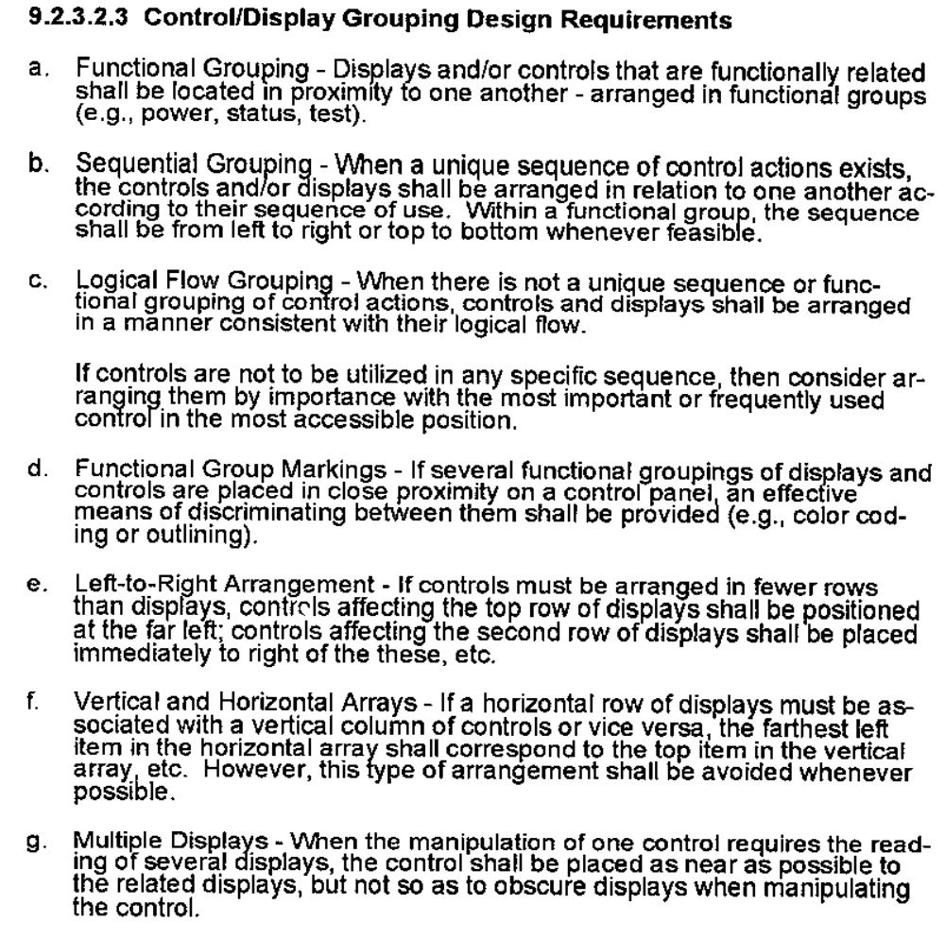
Notes:
Computer based displays have specific features which make them usable or unusable.
Source: NASA STD-3000

Slide 39
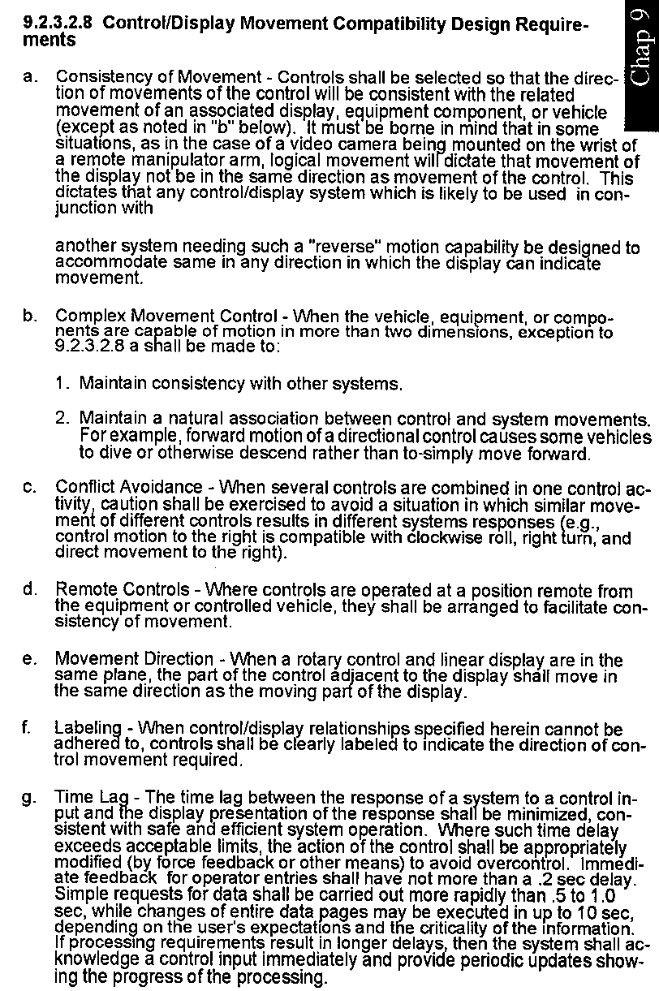

Slide 40
Alarm Classes
In general, three classes of alarms are used in aerospace systems to notify the crew of hazardous or anomalous conditions
Class 1 – Emergency – reserved for life threatening situations that require immediate attention
  Classic examples – loss of cabin pressure, fire/smoke, ground proximity, toxic atmosphere, impending collision (TCAS), stall warning
  Each class 1 alarm typically has a different sound as well as visual indications
Class 2 – Warning – conditions that require immediate correction to avoid loss of mission or crew
  Classic examples – hardware malfunctions, critical system operating limits, critical consumable limits (fuel)
  Typically all warnings have a common aural tone and may have individual visual annunciations
Class 3 – Caution – conditions of a less time critical nature but that require crew attention to avoid degradation into a life threatening situation
  Typically all cautions have a common aural tone and they may have a common visual indicator with a requirement for the crew to look up additional information to determine the exact cause of the alarm

Slide 41
Any questions ?

